Slide 1
MS draft for Mes-13—TIIA—Diabetic Nephropathy
1. ROS
2. IPA
3. RNA-seq+Methyl-seq
4. Validatiton

Slide 2
Identification of novel targets of diabetic nephropathy and PEDF peptide treatment using RNA-seq
Methodology
Library preparation and sequencing
Quality control, mapping and quantification of RNA-Seq reads
Differential Gene Expression (DEG) analysis
Methylation analysis

Slide 3
Fig 1 ROS

Slide 4
A
B
E
C
D
Fig 1. ROS detection

Slide 5
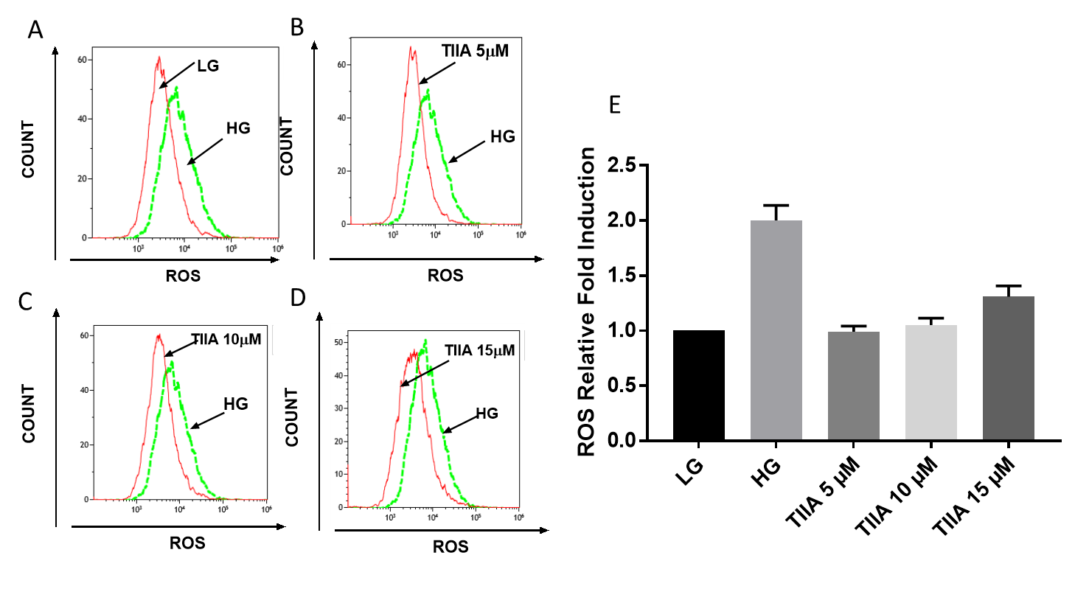

Slide 6
Fig 2 RNA-seq settings and results Select either 2 from the 4 figures
Dear Davit:
Please add legend to Fig2 (Could you please provide normal heatmap also) and write something of method based on the description below.
FastQ files were processed by Renyi (mes13_featurecounts_Dec2017_david.csv) in December 2017
Table contains 24,421 genes found in 3 samples: LG, HG and TIIA
Removed genes with low counts (< 21 across all 7 samples). 13,954 genes left.
Applied DEGseq (“Identify Differentially Expressed Genes from RNA-seq data”, Likun Wang et al)

Slide 8
Normalized log differences
Gene | HG-LG | TIIA-HG
Hsd3b2 | 3.659 | -2.117
5330417C22Rik | 2.681 | -2.460
Mab21l3 | 1.514 | -1.198
Lrrc15 | 1.337 | -1.001
Pkd1l3 | 1.161 | -0.770
Inpp5d | 0.994 | -0.560
Evpl | 0.871 | -0.524
Tdrd5 | 0.801 | -0.894
Kcnj2 | 0.801 | -0.816
Hic1 | 0.782 | -0.683
Bok | -0.563 | 0.656
Rnf144a | -0.568 | 0.535
Itgb6 | -0.663 | -1.626
Tgfb1i1 | -0.712 | 0.817
Acta2 | -0.939 | 0.508
Col7a1 | -1.066 | 0.869
Trabd2b | -1.122 | 0.790
Upk3b | -1.133 | 1.409
Atp2a1 | -2.041 | 1.999
Ankrd61 | -2.626 | 2.114
Il23r | -2.848 | 3.906
31-10
10
366-10
25-10
10
206-10

Slide 10
Fig2 Legend?
263
124
1,393
207
89
1,120

Slide 11
Fig 3. IPA gene, pathway, disease, network analysis

Slide 12
Fig 4. Methyl-seq settings and results
Dear Davit
Please write the legend for fig 4 and arrange fig 4.
Also the related Methodology part. (Applied DSS package)
What is the rule of getting the 20 genes? Cut-off

Slide 17
OLD PLOT!

Slide 18
Fig 5. RNA-seq and Methyl-seq correlation
Dear Davit
Please add the donut heatmap figure and legend here

Slide 19
Figure6 Genes of Interest (4)

Slide 20
 | HG-LG DNA | TIIA-HG DNA | HG-LG-fold | TIIA-HG-fold
Fgl2 | -10.32419281 | 7.26531998 | 5.34555211 | 0.272532
Gulo/(GLO) | 18.5300207 | -14.5256917 | 0.121489821 | 3.997138
Kcnip2/KChIP2 | 11.567276 | -4.748313441 | 0.121489821 | 3.997138
Bmp8b | -1.188811189 | -12.27375566 | 0.2242889 | 5.995706

Slide 21
Entrez Gene Name:
bone morphogenetic protein 8b
Synonym(s):
bone morphogenetic protein 8b, Op3
role in cell:
abnormal morphology, number, lack, apoptosis, development, morphology, quantity, differentiation, proliferation
disease:
growth failure, developmental delay, hyperplasia
Loss of BMP8B substantially increases susceptibility to diet-induced obesity

Slide 22
Entrez Gene Name:
fibrinogen like 2
Synonym(s):
AI385601, fibrinogen-like 2, fibrinogen-like protein 2, FIBROLEUKIN, musfiblp, PCA protein (70 kDa), pT49, T49
role in cell:
degranulation, production in, necrosis, cellular infiltration by, proliferation, apoptosis
disease:
uterine serous papillary cancer, systemic juvenile idiopathic arthritis
Fgl2 Fibrinogen-like protein 2 expression correlates with microthrombosis in rats with type 2 diabetic nephropathy

Slide 23
Entrez Gene Name:
gulonolactone (L-) oxidase
Synonym(s):
5730581M22, AU018375, BC028822, D-Arabino-1,4-lactone oxidase (GULO) similar, GLO, gulonolactone (L-) oxidase, LGO, L-gulono-gamma-lactone oxidase, L-Gulonolactone oxidase, L-gulono-γ-lactone oxidase, LOC100505222, sfx, unh, unhip
role in cell:
number, expression in, proliferation
disease:
weight loss, growth failure, anemia, bleeding, desquamation
the activity of L-gulono-gamma-lactone oxidase (GLO), a terminal enzyme of AA biosynthesis [14], is impaired in diabetic animals and decreased GLO activity impairs the ability to synthesize AA [15].
Impaired ascorbic acid metabolism in streptozotocin-induced diabetic rats

Slide 24
Entrez Gene Name:
potassium voltage-gated channel interacting protein 2
Synonym(s):
AI851528, KCHIP2, Kv channel-interacting protein 2, Kv channel-interacting protein 2-like, LOC100911951, potassium voltage-gated channel interacting protein 2
role in cell:
function, excitability
disease:
systemic lupus erythematosus, arrhythmia, seizures, Huntington disease
Kcnip2/KChIP2 Type 2 diabetes induces subendocardium-predominant reduction in transient outward K+ current with downregulation of Kv4.2 and KChIP2

Slide 25
Fig 7. RNA qPCR validation

